Slide 1
Functional Thinking is SOLID
How Functional Thinking behind your solutions lead to SOLID and clean code base

Slide 2
@chiaradiajm
@chiara-jm
@chiara-jm

Slide 3
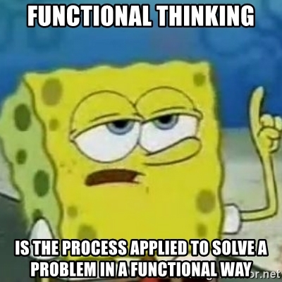
What is Functional Thinking?

Slide 4
Functional programming
Functional programming is a programming paradigm where programs are constructed by applying and composing functions.
It is a declarative programming paradigm in which function definitions are trees of expressions that map values to other values, rather than a sequence of imperative statements which update the running state of the program.
Source: Wikipedia

Slide 5
What is Functional Thinking?
Apply and compose functions
Work with declarative expressions
Avoiding side effects

Slide 6
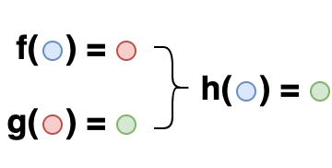
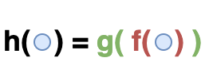
Functional Composition

Slide 7
Functional Composition

Slide 8
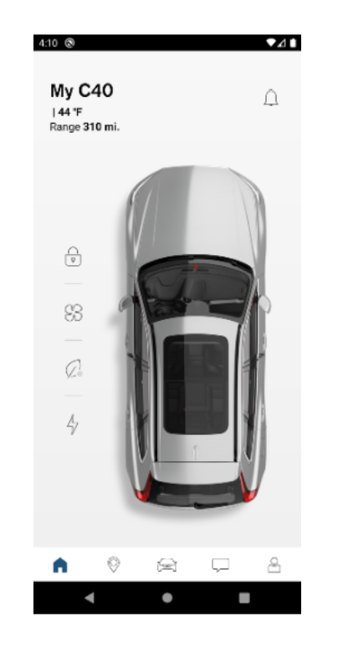
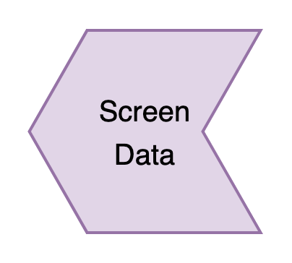
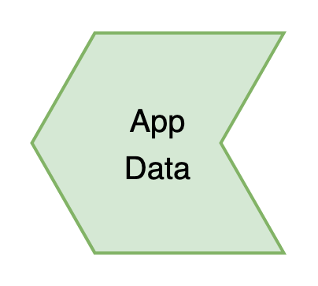
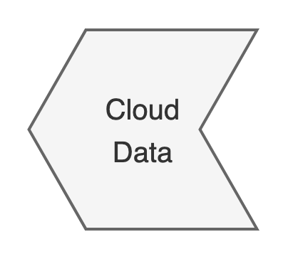
Functional Composition

Slide 9
Functional Composition
CarUI(carId) = CarView(
getCarSnapshot(
getAppCarState(
getCloudCarState(carId)
)
)
)

Slide 10
Functional Composition

Slide 11
Functional Composition
CarView(carSnapshot = carSnapshot)

Slide 12
Functional Composition
val carSnapshot get() =
repository.getCarState(carId).toCarSnapshot()
val carSnapshot by viewModel.carSnapshot.collectAsState()
CarView(carSnapshot = carSnapshot)

Slide 13
Functional Composition
carCloud.getState(carId).toCarState()

Slide 14
Functional Composition
val carSnapshot by viewModel.carSnapshot.collectAsState()
CarView(carSnapshot = carSnapshot)
val carSnapshot get() =
repository.getCarState(carId).toCarSnapshot()
carCloud.getState(carId).toCarState()

Slide 15
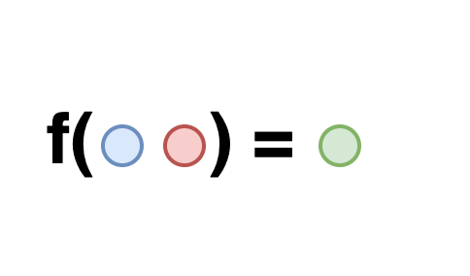
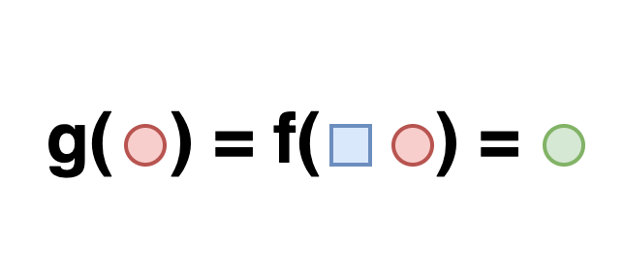
Partial Application

Slide 16
Partial Application
carSnapshot(carId) =
getCarSnapshot(
getAppCarState(
getCloudCarState(carId)
)
)

Slide 17
Partial Application
val carSnapshot by viewModel.carSnapshot.collectAsState()
CarView(carSnapshot = carSnapshot)
val carSnapshot get() =
repository.getCarState(carId).toCarSnapshot()
carCloud.getState(carId).toCarState()

Slide 18
Partial Application

Slide 19
Partial Application
Hide implementation details
Identify dependencies
Dependency Injection

Slide 20
Partial Application
getcarSnapshot(viewModel, appCarState)
getAppCarState(repository, cloudCarState)
getCloudCarState(carCloud, carId)
class Repository(
private val carCloud: CarCloudApi,
) {
fun getCarState(carId: String) =
carCloud.getState(carId).toCarState()
}

Slide 21
High-Order Functions
What?
A function used as a parameter
Why?
Abstract behaviour

Slide 22
High-Order Functions
carSnapshot(carId) =
getcarSnapshot(
getAppCarState(
getCloudCarState(carId)
)
)
carSnapshot(
getcarSnapshot,
getAppCarState,
getCloudCarState,
carId,
) = getcarSnapshot(
getAppCarState(
getCloudCarState(carId)
)
)

Slide 23
High-Order Functions
class GetCarState(
private val repository: Repository
) : (String) -> CarState by repository::getCarState
class ViewModel(
private val carId: String,
private val repository: Repository,
) {
val carSnapshot get() =
repository.getCarState(carId).toCarSnapshot()
}
class ViewModel(
private val carId: String,
private val getCarState: (String) -> CarState,
) {
val carSnapshot get() =
getCarState(carId).toCarSnapshot()
}
class GetCarState(
private val repository: Repository
) : (String) -> CarState {
override fun invoke(carId: String) =
repository.getCarState(carId)
}
val viewModel = ViewModel(
getCarState = GetCarState()
)
val viewModel = ViewModel(
getCarState = repository::getCarState
)

Slide 24
Side Effects

Slide 25
Side Effects
LockButton { viewModel.lock() }
repository.lock(carId)
lock(carId)
carCloud.lock(carId)

Slide 26
Side Effects
val carSnapshot by viewModel.carSnapshot.collectAsState()
CarView(carSnapshot = carSnapshot)
val carSnapshot = getCarStateFlow(carId).map { it.toCarSnapshot() }
carCloud.lock(carId)
.onSuccess { publishCarState() }

Slide 27
Homework
Reactive Programing
kotlinx.coroutines.flow
Immutability
val myField
Separate data and behaviour
data class
lock(carId)
Monadic Error Handling
kotlin.Result

Slide 28
How does all this relate to SOLID?

Slide 29
Single Responsibility
An object should only have a single responsibility, that is, only changes to one part of the software's specification should be able to affect the specification of the object.
The compositional nature of functional programing will allow us to focus on one responsibility at a time.
A function converts the given input into the expected output
The lack of side-effects (or limiting them to the ends of our layered architecture) enforces the SRP.
A function calculates a value or generates a side effect, but not both.

Slide 30
Single Responsibility
val carSnapshot by viewModel.carSnapshot.collectAsState()
CarView(carSnapshot = carSnapshot)
val carSnapshot get() = getCarState(carId).map { it.toCarSnapshot() }
carStateFlow.emit(carCloud.getState(carId).toCarState())

Slide 31
Open Close Principle
"Software entities ... should be open for extension, but closed for modification."
class ViewModel(
private val carId: String,
private val getCarState: (String) -> CarState,
)
High-Order Functions together with Dependency Injection allow us to extend without modifying.
Reactive programming + immutability (Homework)

Slide 32
Liskov Substitution
An object (such as a class) and a sub-object (such as a class that extends the first class) must be interchangeable without breaking the program
class ViewModel(
private val carId: String,
private val getCarState: (String) -> CarState,
)
class ViewModel(
private val carId: String,
private val getCarState: (String) -> Result<CarState>,
)
Avoid side-effects
Monadic error handling
Immutability

Slide 33
Interface Segregation
Many client-specific interfaces are better than one general-purpose interface.
class ViewModel(
private val carId: String,
private val getCarState: (String) -> CarState,
)
class ViewModel(
private val carId: String,
private val repository: Repository,
)
Thinking in terms of High-Order functions as dependencies ensures that the client only depend on what it needs and not more.

Slide 34
Dependency Inversion
High level modules should not depend on low level modules; both should depend on abstractions. Abstractions should not depend on details. Details should depend upon abstractions
The abstraction is given by the High-Order functions.
getCarState:(String) -> CarState
The presentation layer consumes the HOF definition
ViewModel(getCarState:(String) -> CarState)
The data layer will implement that definition
repository::getCarState
The High-Order function definition (String) -> CarState is agnostic from both presentation and data layers.

Slide 35
Closing notes
OOP and FP can be “best-friends”
You do not need to go functional all the way
It can take some practice to break old routines
FP composition is a real powerful tool

Slide 36
One final note
There is a SpongeBob gif for everything

Slide 37
Questions?
About FP and Kotlin?
About working at Volvo?
About me?

